Slide 1
Notes to Users
This sample presentation is designed to serve as a customizable template to present NSSE, BCSSE, or FSSE results on your campus. The presentation is divided into the following topical sections to help you quickly select the slides most appropriate for a particular audience:
NSSE and the Concept of Student Engagement
Selected NSSE Results for [Institution]
Selected BCSSE Results for [Institution]
Selected FSSE Results for [Institution]
User Resources and Activities of the NSSE Institute
Using Your NSSE, BCSSE, and FSSE Data
Questions & Discussion
Contact Information
Replace the cover slide and the red text throughout this presentation with the name of your school and your own results.
Use slides from the “Selected Results for [Institution]” sections for ideas on how to present your campus results.
View the notes section of each slide for additional information or relevant talking points (in the PowerPoint tool bar select “VIEW” then “Notes Page”)
Notes:
Check this notes section throughout the presentation for suggestions on how to utilize slides and additional information that can serve as background information or “talking points” during your presentation.
To view this notes section of the presentation, select the “View” tab, then the “Notes Page” option.
NSSE recommends adding your own notes and talking points to this section, then print off a notes version for use during your presentation. To do so, select “File,” then “Print,” then change settings to: “Notes Pages.”

Slide 2
Insert Presenter Name(s) Here Insert Presentation Date
Notes:
Replace all text in red with institutional information. You may also want to replace the photos here and throughout with images from your campus.
Insert Presenter Name(s) Here
Insert Presentation Date

Slide 3
Presentation Overview
NSSE and the Concept of Student Engagement
Selected NSSE Results for [Institution]
Selected BCSSE Results for [Institution]
Selected FSSE Results for [Institution]
User Resources
Using Your NSSE, BCSSE, and FSSE Data
Questions & Discussion
Contact Information
Notes:
Adapt this slide to fit the outline of your presentation.

Slide 4
NSSE and the Concept of Student Engagement
Notes:
NSSE and the Concept of Student Engagement

Slide 5
What is Student Engagement?
What students do – Time and energy devoted to studies and other educationally purposeful activities
What institutions do – Using resources and effective educational practices to induce students to do the right things
Educationally effective institutions channel student energy toward the right activities
Notes:
5
Development of Concept of Student Engagement
C. Robert Pace (1970s)
Pioneer of looking at the entire student experience versus just looking at test scores or grades to assess student learning.
Explored students’ academic and social experiences in college – and assessed the quality of effort students put forth in their educational experiences
Alexander Astin (Hired by Pace at UCLA in 1980s)
Promoted theory of student involvement
Amount of learning taking place directly proportional to quantity and quality of energy invested in educational activities
Vincent Tinto (Also in the 1980s)
Retention model – focus on greater social and academic integration, both formal and informal processes -> greater satisfaction -> more likely to stay
Ernest Pascarella & Patrick Terenzini
Examined impact of college experience.
Arthur Chickering and Gamson (1980s analysis of hundreds of studies over several decades)
Good practice in undergraduate education includes: 1) Student-faculty contact, 2) Cooperation among students, 3) Active learning, 4) Prompt feedback, 5) Time on task, 6) High expectations, 7) Respect for diverse talents and ways of learning
George Kuh (1990s – idea of student engagement)
What students do -- time and energy devoted to educationally purposeful activities
What institutions do -- using effective educational practices to induce students to do the right things

Slide 6
Seven Principles of Good Practice in Undergraduate Education
Student-faculty contact
Active learning
Prompt feedback
Time on task
High expectations
Experiences with diversity
Cooperation among students
Chickering, A. W. & Gamson, Z. F. (1987). Seven principles for good practice in undergraduate education. AAHE: Bulletin, 39 (7), 3-7.
Notes:
6

Slide 7
Other Supporting Literature
Traces the development of student engagement as a research-informed intervention to shift the discourse on quality in higher education to emphasize matters of teaching and learning while providing colleges and universities with diagnostic, actionable information that can inform improvement efforts.
McCormick, A. C., Kinzie, J., & Gonyea, R. M. (2013). Student engagement: Bridging research and practice to improve the quality of undergraduate education. In M. B. Paulsen (Ed.), Higher education: Handbook of theory and research (pp 47-92), Vol. 28. Springer Netherlands.
After a review of thousands of studies on college students from 1970 through the 1990s, Ernest Pascarella and Patrick Terenzini concluded student engagement is a central component of student learning. The Volume 3 update (Mayhew et. al, 2016) adds further evidence
Pascarella, E. & Terenzini, P (2005). How college affects students: A third decade of research. San Francisco: Jossey-Bass Publishers.
Mayhew, M. et al., (2016). How college affects students: 21st century evidence that higher education works. San Francisco: Jossey-Bass Publishers.
Presents institutional policies, programs, and practices that promote student success. Provides practical guidance on implementation of effective institutional practice in a variety of contexts.
Kuh, G. D., Kinzie, J., Schuh, J. H., Whitt, E.J., & Associates (2005/2010). Student success in college: Creating conditions that matter. San Francisco: Jossey-Bass.
Notes:
7

Slide 8
NSSE Background
Launched with grant from The Pew Charitable Trusts in 1999, supported by institutional participation fees since 2002.
Institution types, sizes, and locations represented in NSSE are largely representative of U.S. baccalaureate institutions.
Nearly 1700 baccalaureate-granting colleges and universities in the US and Canada have participated to date.
Year | Institutions
2001 thru 2015 | 1600
2016 | 557
2017 | 722
2018 | 505
2019 | 531
2020 | 601
2021 | 356
Notes:
How and why was the NSSE survey developed?
NSSE was specifically designed to assess the extent to which students are engaged in empirically derived effective educational practices and what they gain from their college experiences. Voluminous research on college student development shows that the time and energy students devote to educationally purposeful activities is the single best predictor of their learning and personal development. Therefore, the main content of the NSSE instrument represents student behaviors that are highly correlated with many desirable learning and personal development outcomes of college.
The original Design Team, convened by The Pew Charitable Trusts in 1988, consisted of Alexander Astin, Gary Barnes, Arthur Chickering, Peter Ewell, John Gardner, George Kuh, Richard Light, and Ted Marchese with input from C. Robert Pace to help draft a survey instrument.

Slide 9
Goals of NSSE Project
Focus conversations on undergraduate quality
Enhance institutional practice and improvement initiatives
Foster comparative and consortium activity
Provide systematic national data on “effective educational practices”

Slide 10
NSSE Survey Content
Engagement in meaningful
academic experiences
Student learning
& development
Engagement in High-Impact Practices
Student reactions
to college
Student background
information
Notes:
The NSSE survey asks students to report the frequency with which they engage in activities that represent effective educational practice. Students also record their perceptions of the college environment associated with achievement, satisfaction, and persistence. Then, students estimate their educational and personal growth since starting college. Finally, students provide information about their background, including age, gender, race or ethnicity, living situation, educational status, and major field.

Slide 11
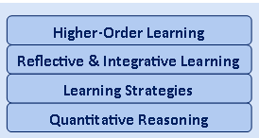
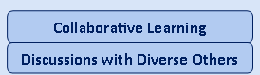
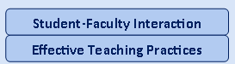
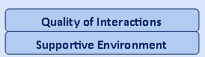
NSSE Engagement Indicators
Engagement Indicators
Engagement Themes
Academic Challenge
Learning with Peers
Experiences with Faculty
Student – Faculty Interaction
Campus Environment
Notes:
11

Slide 12
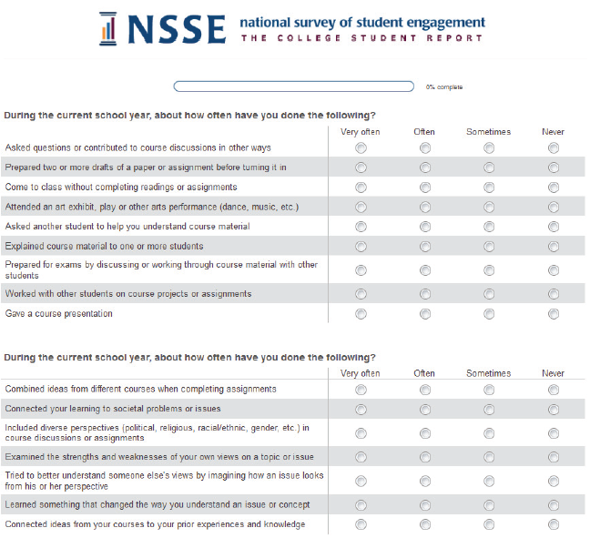
Survey Administration
Census-administered or randomly sampled first-year students & seniors
Mobile-optimized survey
Spring administration
Multiple follow-ups to increase response rates
Topical Modules provide option to delve deeper into the student experience
Consortium participation enables addition of custom questions
Notes:
The Center for Survey Research at Indiana University helps NSSE administer the survey in the field. See: csr.indiana.edu for more information.
NSSE survey design:
Relatively short survey
Items directly related to college outcomes
Administered to first-year and senior students at 4-year institutions
Administered directly by a credible third-party survey organization

Slide 13
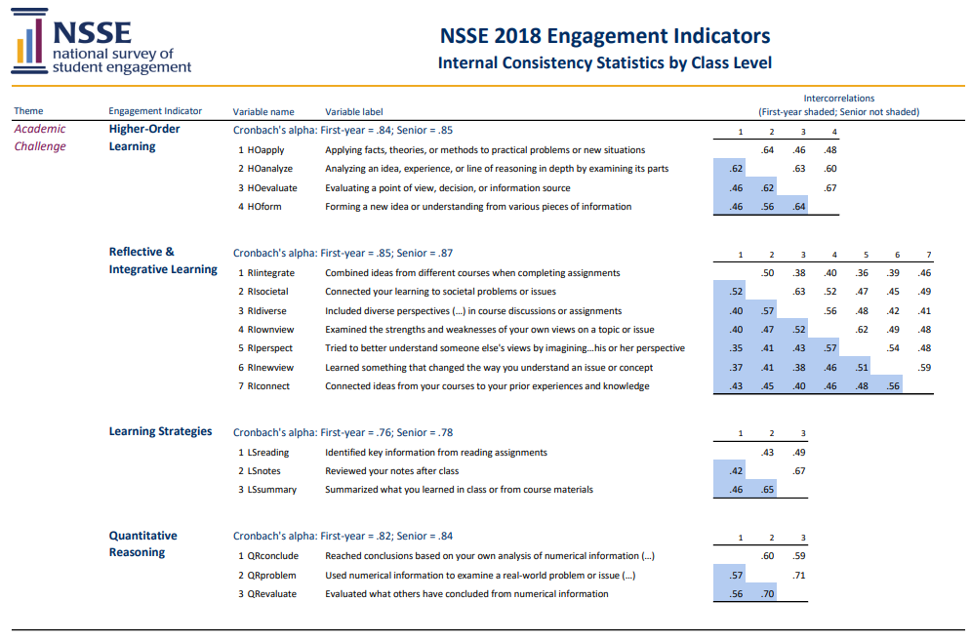
A Commitment to Data Quality
NSSE’s Psychometric Portfolio presents evidence of validity, reliability, and other indicators of data quality. It serves higher education leaders, researchers, and professionals who use NSSE.
See the Psychometric Portfolio
nsse.indiana.edu/nsse/psychometric-portfolio

Slide 14
Selected NSSE Results for [Institution]
Notes:
Selected NSSE Results for [Institution]

Slide 15
NSSE 2021 Institutions by Carnegie Classification
Notes:
NSSE 2021 participating institutions and students reflect the diversity of bachelor’s-granting colleges and universities in the US with respect to institution type, public or private control, size, region, and locale. A searchable list of participating institutions is on the NSSE website: nsse.indiana.edu/support-resources/participating-institutions/index.html

Slide 16
NSSE 2021 Percentage Respondents by Race, Ethnicity, and Nationality
Race/Ethnicity | NSSE 2021 Respondents | U.S. Bachelor’s-Granting Population
African American/Black | 10 | 12
American Indian/Alaska Native | <1 | 1
Asian | 6 | 7
Native Hawaiian/other Pacific Islander | <1 | <1
Caucasian/White | 62 | 54
Hispanic/Latino | 15 | 17
Multiracial/multiethnic | 4 | 4
Foreign/nonresident alien | 3 | 5
Notes:
Note: Percentages are unweighted and may not sum to 100 due to rounding. Institution-reported, using categories provided in IPEDS. NSSE percentages do not include students with “another” or “unknown” sex (0.1% of all respondents) or unknown race/ethnicity (11% of all respondents). The NSSE 2021 sampling frame consists of first-year and senior undergraduates. Data were provided by participating institutions. U.S. percentages are based on data from the 2019 IPEDS Institutional Characteristics and Enrollment data. Includes all class years.

Slide 17
NSSE 2021 Survey Population and Respondents
Approximately 890,000 students were invited to participate in NSSE 2021, with 211,667 responding.
x [Institution] students were invited to participate, with x responding.

Slide 18
NSSE 2021 U.S. Institution Response Rates
[Your institution’s] response rate = x%
All US NSSE 2021 institutions = 30%
NSSE 2021 U.S. Average Institutional Response Rates by Enrollment:
Undergraduate Enrollment | 2020 | 2021
2,500 or fewer | 36 | 35
2,501 to 4,999 | 28 | 30
5,000 to 9,999 | 25 | 24
10,000 or more | 23 | 22
All institutions | 30 | 30
Notes:
The average response rate for U.S. NSSE 2021 institutions was 30%, consistent with last year. The highest response rate among U.S. institutions was 93%, and about three out of five achieved a response rate of 25% or higher. Higher average response rates were observed for smaller institutions and at institutions that offered incentives for survey participation.

Slide 19
NSSE 2021 Results (Sample Slides)
The following slides are examples of how your institution might share selected NSSE results with various institutional constituencies. Expand this section to highlight items of interest to your audience.
Notes:
19

Slide 20
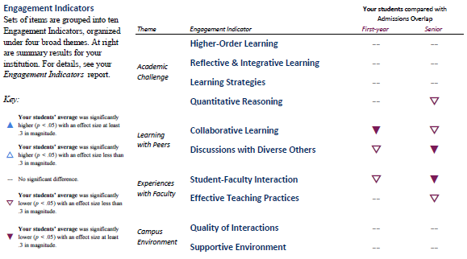
Overall results compared to peer group for each Engagement Indicator
Notes:
This is a “snip” from the Snapshot. You can copy and paste this image from your snapshot directly into this slide for presentation.
Engagement Indicators: Sets of items are grouped into ten Engagement Indicators, which fit within four themes of engagement. At right are summary results for your institution. For details, see your Engagement Indicators report.

Slide 21
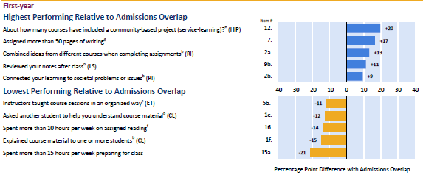
Highest and lowest performing items compared to peer group (FY)
Notes:
This is a “snip” from the Snapshot. You can copy and paste images from your Snapshot directly into this slide for presentation. This slide is showing the highest and lowest performing items for first-year students at [Institution] compared to the peer group that was selected for use in the Snapshot.

Slide 22
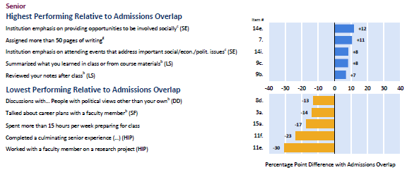
Highest and lowest performing items compared to peer group (SR)
Notes:
This is a “snip” from the Snapshot. You can copy and paste images from your Snapshot directly into this slide for presentation. This slide is showing the highest and lowest performing items for seniors at [Institution] compared to the peer group that was selected for use in the Snapshot.

Slide 23
Engagement Indicator: Quality of Interactions
Indicate the quality of your interactions with the following people at your institution. (First-year students)
Notes:
These numbers for your institution can be found in the NSSE 2021 Frequencies and Statistical Comparisons.
To modify this chart, double click on the chart, select the “sheet 1” tab and insert your data, then select the “chart” tab.

Slide 24
Engagement Indicator: Discussions with Diverse Others
How often have you had discussions with people from the following groups? (First-year students)
Notes:
These numbers for your institution can be found in the NSSE 2021 Frequencies and Statistical Comparisons.
To modify this chart, double click on the chart, select the “sheet 1” tab and insert your data, then select the “chart” tab.

Slide 25
High‐Impact Practices (FY)
Percentage of first-year students who participated in a learning community and in course-based service-learning.
Notes:
These numbers for your institution can be found in the NSSE 2021 Frequencies and Statistical Comparisons.
To modify this chart, double click on the chart, select the “sheet 1” tab and insert your data, then select the “chart” tab.

Slide 26
Engagement Indicators: LS and CL (First-Year Students)
Learning Strategies and Collaborative Learning (First-Year Students)
Notes:
These numbers for your institution can be found in the NSSE 2021 Engagement Indicators.
To modify this chart, double click on the chart, select the “sheet 1” tab and insert your data, then select the “chart” tab.

Slide 27
High‐Impact Practices (SR)
Percentage of seniors who worked on a research project with a faculty member, and who did a culminating senior experience.
Notes:
These numbers for your institution can be found in the NSSE 2021 Frequencies and Statistical Comparisons.
To modify this chart, double click on the chart, select the “sheet 1” tab and insert your data, then select the “chart” tab.

Slide 28
Engagement Indicators: HO and SF (Seniors)
Higher-Order Learning and Student-Faculty Interaction (Seniors)
Notes:
These numbers for your institution can be found in the NSSE 2021 Engagement Indicators.
To modify this chart, double click on the chart, select the “sheet 1” tab and insert your data, then select the “chart” tab.

Slide 29
How do students spend their time? Preparing for Class
Percentage spending more than 10 hours per week preparing for class
Class | [Institution] | Selected Peers
First-Year | More than x% | More than x%
Senior | More than x% | More than x%
Notes:
These numbers for your institution can be found in the NSSE 2021 Frequencies and Statistical Comparisons.

Slide 30
How do students spend their time? Co-Curricular Activities
Percentage of students spending more than 5 hours per week participating in co-curricular activities
Class | [Institution] | Selected Peers
First-Year | More than x% | More than x%
Senior | More than x% | More than x%
Notes:
While college is organized around formal learning venues (classrooms, laboratories, studios), it is clear from the many desired outcomes associated with out-of-class experiences that engaging students in more educationally purposeful activities outside the classroom would be valuable. Students of all backgrounds seem to benefit from such experiences.

Slide 31
Selected BCSSE Results for [Institution]
Notes:
Selected BCSSE Results for [Institution]

Slide 32
BCSSE Purpose
BCSSE has common content for all students regarding their academic expectations and perceptions for the coming year. There are also BCSSE questions specific to first-year, transfer, and older students. These targeted questions provide a more in-depth understanding of each of these unique groups of students.

Slide 33
BCSSE Survey Content
There are three sections to the BCSSE survey:
Prior educational experiences
Expectations and beliefs regarding the upcoming college year
Background characteristics

Slide 34
Administration Modes
Paper, Web, or Mixed Modes
Paper group administration
(FY only)
Orientation, Welcome Week, etc.
Web group administration
While students are in computer lab, etc.
Web email administration
Web link emailed to students

Slide 35
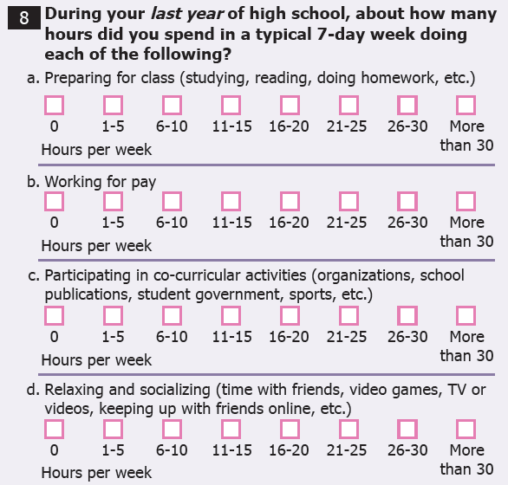
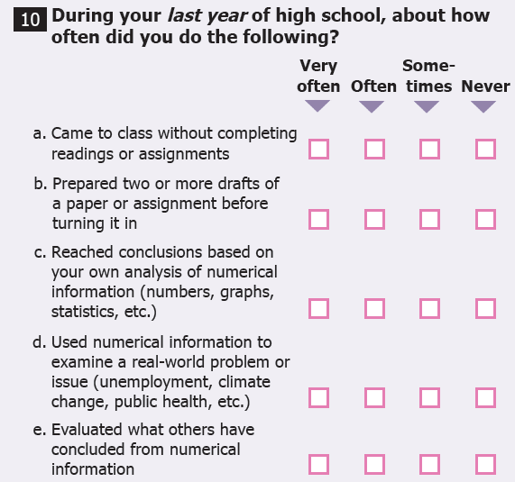
BCSSE: Prior Educational Experiences

Slide 36
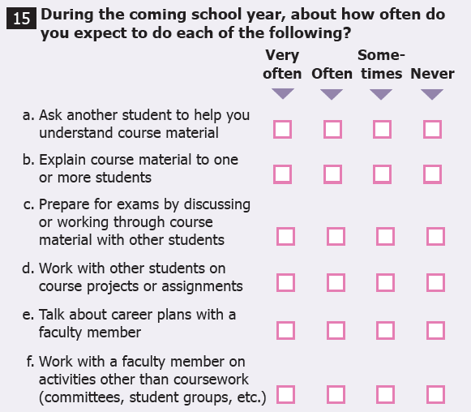
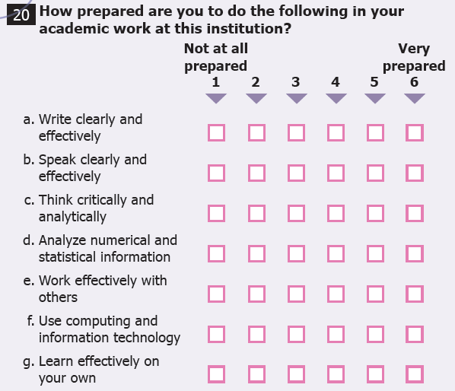
BCSSE: Expectations for the First Year of College

Slide 37
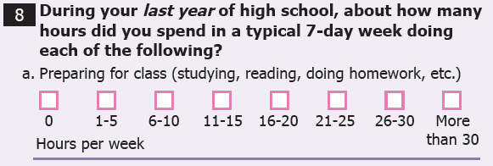
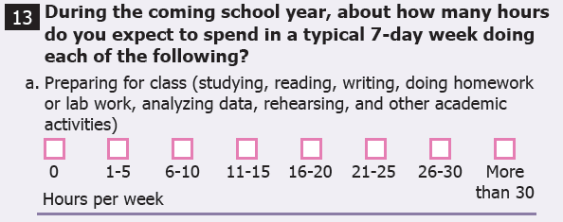
BCSSE-NSSE
Many of these questions are designed to be paired with NSSE, providing an in-depth view of the first-year experience.
BCSSE
NSSE

Slide 38
BCSSE Scales
BCSSE Scales | Corresponding NSSE Engagement Indicator
High School Quantitative Reasoning | ü
High School Learning Strategies | ü
Transfer Student Learning Strategies (Transfer student only) | ü
Expected Student-Faculty Interactions | ü
Expected Collaborative Learning | ü
Expected Discussions with Diverse Others | ü
Importance of Campus Environment | ü
Expected Academic Perseverance | *
Expected Academic Difficulty | *
Expected Academic Help-Seeking | *
Perceived Academic Preparation | * *
* Items in these three BCSSE scales also correspond to NSSE’s First-Year Experience Module
** Items in this BCSSE scale also correspond to NSSE’s personal gains items

Slide 39
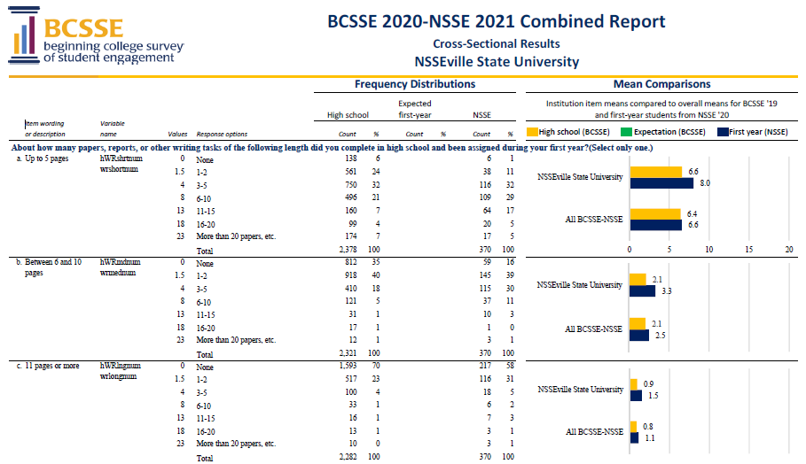
BCSSE Reports
Four reports are provided:
BCSSE Institutional Report (Summer/Fall 2020)
BCSSE Student Advising Report (Summer/Fall 2020)
Grand Frequencies and Means (Fall 2020)
Overall
Institution types
BCSSE-NSSE Combined Report (Summer 2021)

Slide 40
During Last Year of High School
About how many hours preparing for class (studying, doing homework, rehearsing, etc.)
Notes:
One way to present your data is to examine responses to individual items from the BCSSE 2020 Frequency Distributions. See the BCSSE Institutional Report 2020 for other ideas and assistance with interpretation.
To modify this chart, double click on the chart, click on “Edit Data” above and insert your data, then close the Excel sheet.

Slide 41
During the coming school year, how difficult do you expect the following to be?
Learning course material
Notes:
One way to present your data is to examine responses to individual items by groups of students relevant to your campus (e.g., first-generation status) from the BCSSE 2020 Frequency Distributions. See BCSSE Institutional Report 2020 for other ideas and assistance with interpretation
To modify this chart, double click on the chart, click on “Edit Data” above and insert your data, then close the Excel sheet.

Slide 42
BCSSE 2019-NSSE 20 Combined Results for [Institution]
Results by Expectations and Whether Expectations Were Met
Notes:
The BCSSE-NSSE report provides cross-sectional and longitudinal analysis. For example, in this slide you can examine student expectations for studying by their response to the BCSSE scales. You can then examine BCSSE scale means by whether or not these student met their expectations for studying. These results also include NSSE Engagement indicators and break down by high school grades (A- or higher and B+ or lower). See your BCSSE-NSSE Combined Report for more details.

Slide 43
Selected FSSE Results for [Institution]

Slide 44
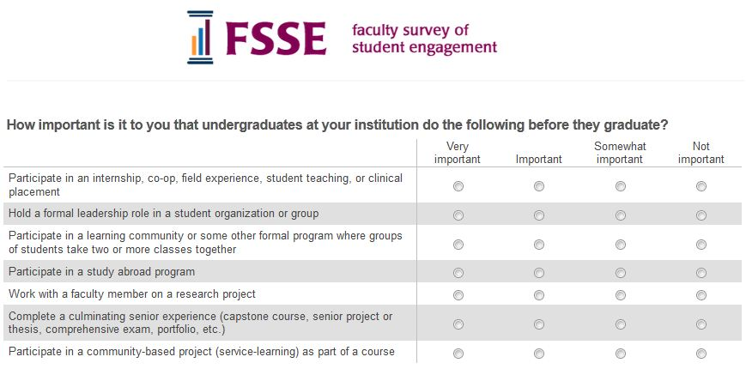
Faculty Survey of Student Engagement
(FSSE is pronounced “fessie”)
College faculty survey that measures faculty expectations for student engagement in educational practices that are empirically linked with student learning and development
Notes:
44

Slide 45
FSSE Survey Content
How often faculty use effective teaching practices
How much faculty encourage students to collaborate
The nature and frequency of faculty-student interactions
Opportunities to engage in diverse perspectives
The importance faculty place on increasing institutional support for students
The importance faculty place on various areas of learning and development
How faculty members organize their time, both in and out of the classroom

Slide 46
FSSE 2021 Project Scope
In 2021, more than 9,000 faculty members from 75 institutions responded to the survey.
In 2021, 31% of the faculty contacted responded to the survey.
Response rates at individual institutions ranged from 11% to 75%.
The average institutional response rate was 39%.

Slide 47
FSSE Administration
Third-party administration in the spring
Institutions choose faculty to be surveyed
Faculty responses are kept anonymous
Administered as an online-only survey
Institutions are able to add topical modules and consortium items to the end of the core FSSE instrument

Slide 48
Faculty Values and Student Participation in High-Impact Practices
Faculty- Very Important or Important
Intentionally left blank
High-Impact Practice | [Institution] | FSSE | [Institution] | NSSE | [Institution] | NSSE
Internship |  | 83% |  | --- |  | 42%
Learning Community |  | 54% |  | 9% |  | 20%
Study Abroad |  | 36% |  | --- |  | 10%
Research with Faculty |  | 57% |  | 4% |  | 20%
Culminating Senior Experience |  | 85% |  | --- |  | 42%
Service-Learning |  | 64% |  | 45% |  | 58%
First-Year Participation
Senior Participation
Notes:
To edit this chart, simply enter new data from your FSSE 2020 Institutional Report in the table cells.
Faculty responses are to how important it is to them that undergraduates at their institution do the following before they graduate.
Student responses are to whether or not they have participated in the listed activities. Student responses to service-learning indicate that at least some of their courses included a service-learning experience. Student percentages are weighted by sex, enrollment status, and institution size.

Slide 49
Questions & Discussion

Slide 50
Contact Information
[Institution]
NSSE Contact:
[Contact name]
[Contact email address]
Center for Postsecondary Research
Indiana University School of Education
201 North Rose Avenue
Bloomington, IN 47405-1006
Phone: 812-856-5824
Fax: 812-856-5150
Email: nsse@indiana.edu
Web: nsse.indiana.edu
Twitter: @NSSEsurvey, @NSSEinstitute
Blog: NSSEsightings.Indiana.edu
.
Notes:
If you have additional questions, feel free to contact the NSSE main office at 812-856-5824.
The NSSE Web site has updated information on NSSE project initiatives, background information, research, news articles, and more. On the website, you can find:
Complete list of all participating colleges and universities for NSSE 2000 through NSSE 2021
NSSE origins, conceptual framework, and psychometrics information
Electronic copies of NSSE national reports
Articles in national publications and colleges/university newspapers about NSSE
Research articles on web and paper mode, the disengaged commuter student, using focus groups to establish validity and reliability, and more
List of recent and upcoming NSSE conference presentations
NSSE electronic newsletter (NSSE e-News) with updates, tips and current events
Registration information for NSSE, BCSSE, or FSSE

Slide 51
Institutional Photo Credits
Thank you to NSSE participating schools for the use of their institutional photos in the development of this PowerPoint template. We encourage you to insert your own campus photos for use in presentations.
.

